Slide 1
Correction reference with picture links & text
Final Website Look @navaccount.com

Slide 2
Home Page hierarchy list
Make a payment button row – no change
Logo + menu tabs – logo is blurry on desktop, but good on mobile
Banner with motion – must need motion in picture
Why to choose us – good, just bring it immediate under the banner
Accomplishment Section – Refer slides (left and center space)
What makes us reliable Section – good, put all in vertical manner on left hand side
Our Services – need changes - interlinked with each specific service section
Our Professional Values – good on place it on center horizontally
What people says about us – Google review link ref source
Updated 3 step process – put it as horizontal manner with new text – refer slide
Schedule a meeting – need box frame in the back of this
CEO Quote Row – Refer slides
Footer Section - Good

Slide 3
Home Page – Banner Section
It must have motion
Use this text – “ Your Virtual Accounting & Tax Office”
Tracking | Analyzing | Reporting
https://www.canva.com/design/DAGevm1mfSQ/gC2h9fHX3wl4_pNKyGO89w/edit?utm_content=DAGevm1mfSQ&utm_campaign=designshare&utm_medium=link2&utm_source=sharebutton
There is vertical link with current link – referred Screenshot on next page – need to remove

Slide 4
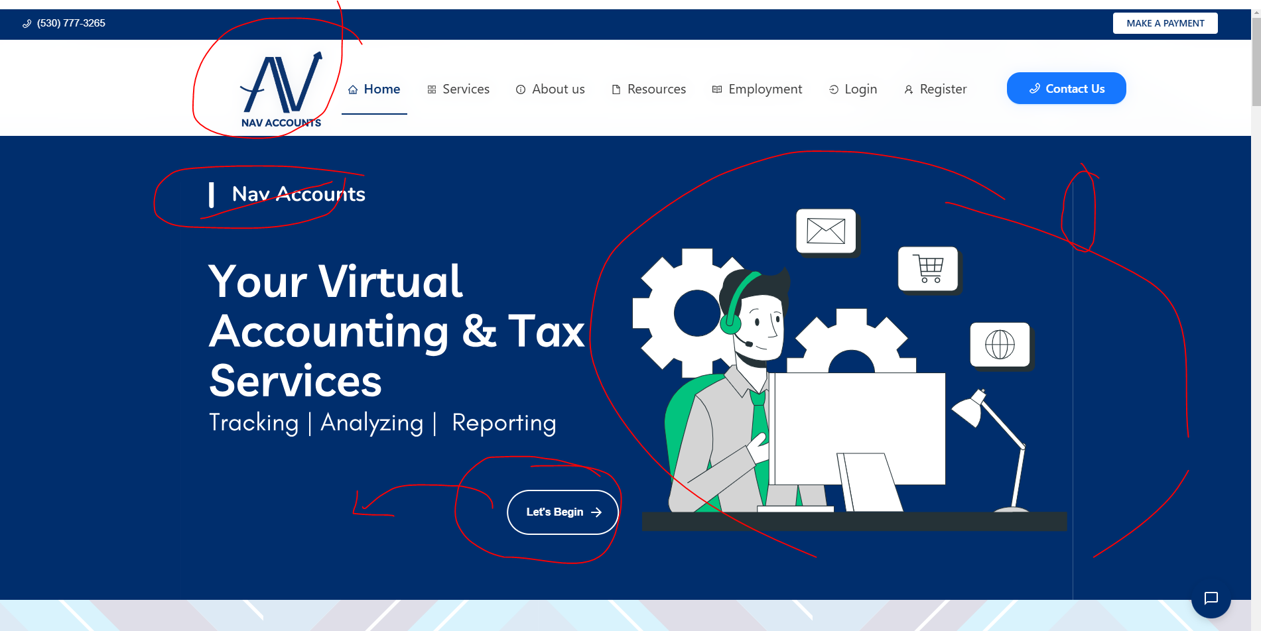
Arrowed line need to fix – motion was missing

Slide 5
Home Page – Accomplishment Section
Blue box keep it – please update the text with the following one
Nav Accounts is owned by Navrisham Khaira as solopreneur. She is passionate about helping individuals and businesses navigate the complexities of tax laws to maximize savings and ensure long-term financial success, along with sharing tech associated compliance with small business owners data protection.
We talk only when we had achieved for real. That make countable for your opportunities to assist you with our business solution with our commitment to serve as best of our understanding. These numbers are based on year 2022 to 2024.
Update the Orange Box with counter number – with new color scheme; here is link.
https://www.canva.com/design/DAGe8k5GPt4/kAxRo3f69MpfCZTC9ksGHg/edit?utm_content=DAGe8k5GPt4&utm_campaign=designshare&utm_medium=link2&utm_source=sharebutton
Keep these 2 boxes in left hand side

Slide 6
Home Page – What people says about us
Here is google review link
https://g.co/kgs/DG62NUE
https://www.google.com/search?sca_esv=60bfaf3935edaa1a&sxsrf=AHTn8zoYbuT6YPlR7kUfdV6D1O8Jrdmkcw:1739341064607&kgmid=/g/11py9_4tpc&q=Nav+Accounts&shndl=30&source=sh/x/loc/hdr/m1/2&kgs=07fef2bfbaf5b155#mpd=~11202686739402224206/customers/reviews
Base frame with color # 89E4B8 & Text color should be #000080 and keep changing each review, here is reference Canva link https://www.canva.com/design/DAGfHKyg8_E/9Glf06H4xyMa6TgAdr0bOA/edit?utm_content=DAGfHKyg8_E&utm_campaign=designshare&utm_medium=link2&utm_source=sharebutton

Slide 7

Home Page - Our Services
Our Service should be look like this.
Rounded Rows
Each service connected with Service tab – Abc service section specifically.
Heading should be prominent, similar font style

Slide 8
Home Page – CEO Quote
* Need a frame with color reference from Canva - #2d9cdd for Schedule a meeting
* Text Color in Dark Blue; this is color reference from Canva - #000080
* Use the Background Color - # B3E3FF
*Need a frame with color reference from Canva - #36a6e6 for CEO Quote.
* Text in just line, second line for Navrisham Khaira CEO Quote.

Slide 9
Service Page – Text & FAQS
Top Banner
On the service page, it need to in appears like business resource box by each service section.
All services should be fine as listed on doc file, there is no need to add one line description
FAQ – from doc file
3 step process
Schedule meeting link

Slide 10
Resource Page – Text & FAQS
Top Banner
All resources section – please increase the text size, we have enough space on page
FAQ for Resource

Slide 11
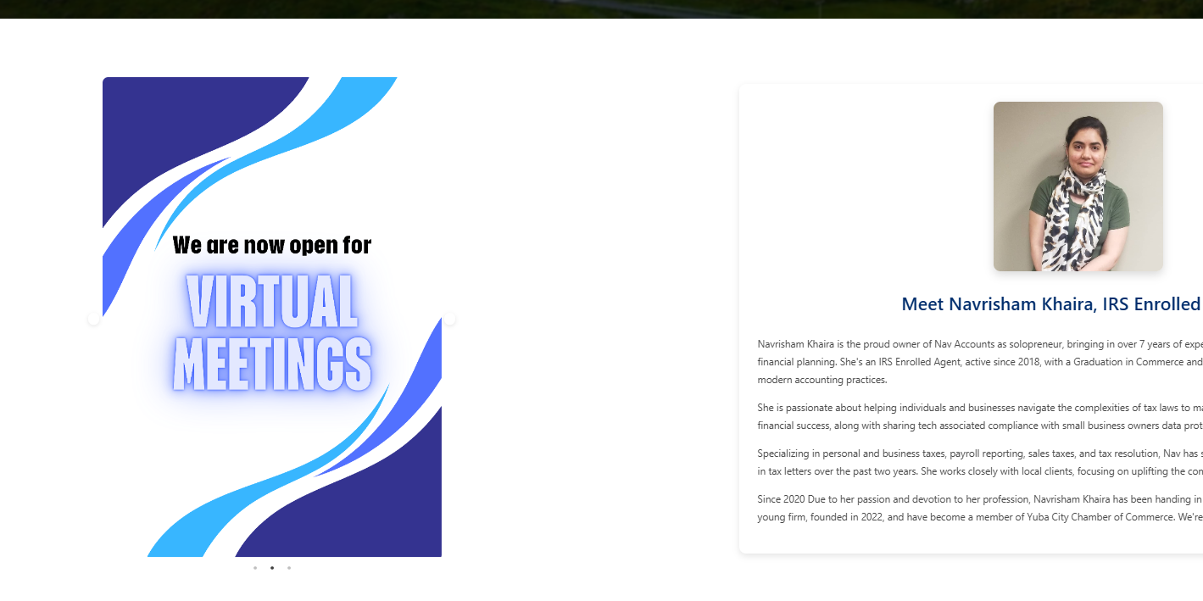
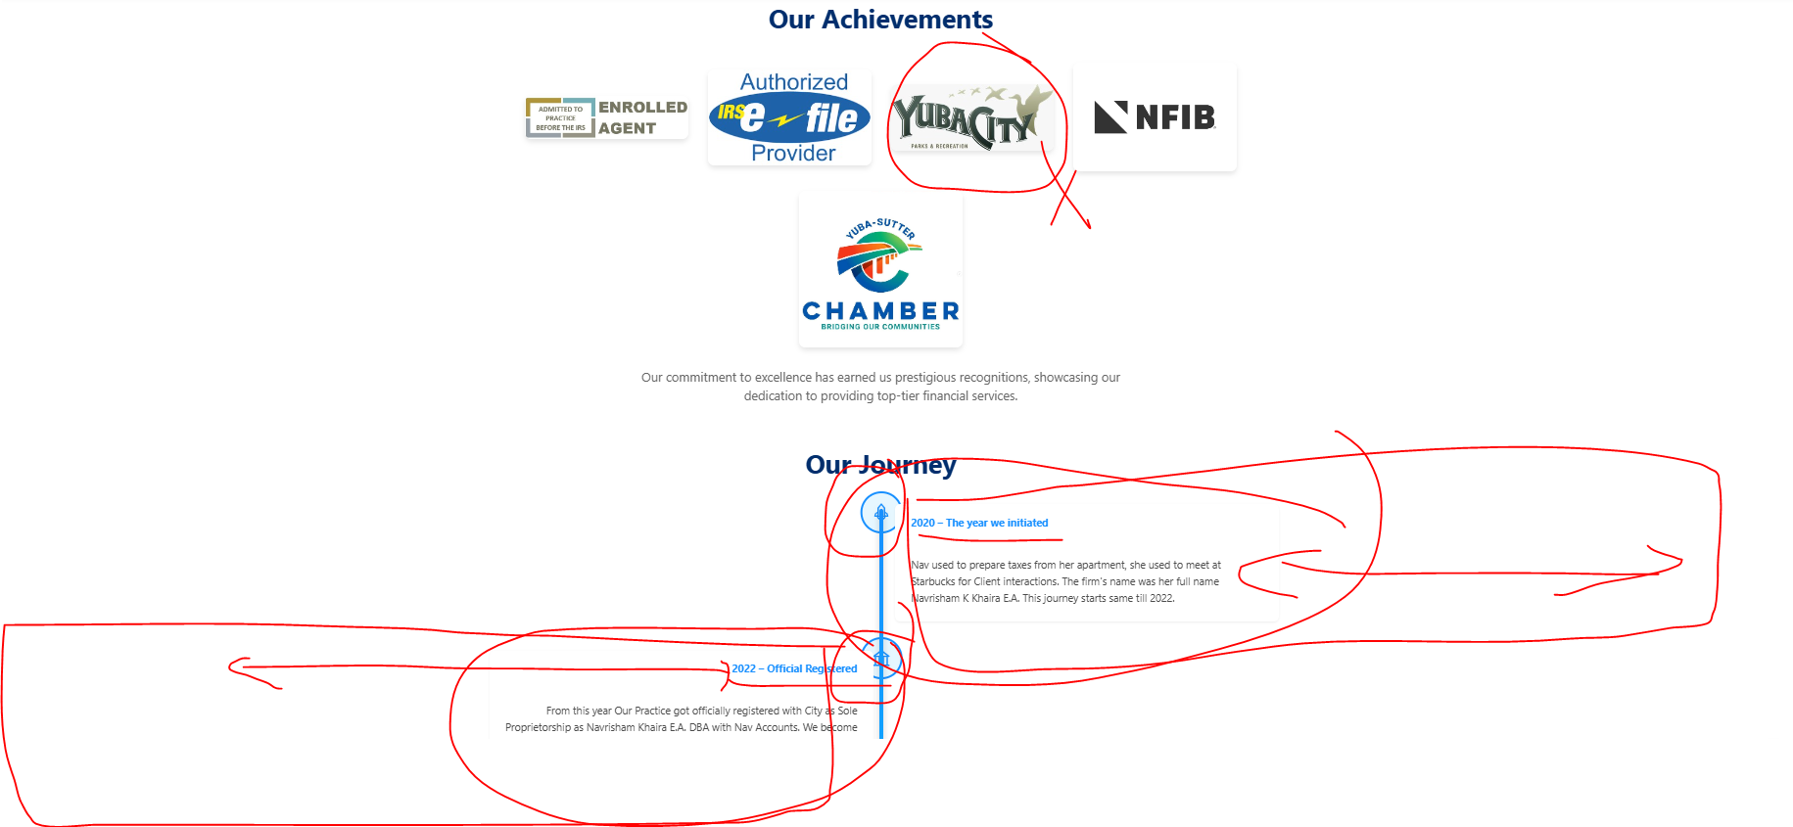
About Section
Remove the other pictures from the slider, I like this one, keep it.
Remove the Yuba City logo
On our journey section – please increase the size of icons & fonts & make space to visibility of icons. We have enough space on the page.
On next page canva links of picture need to add on that slider, place where arrow directed.

Slide 12
About section Slider need to add
https://www.canva.com/design/DAGMeGw1Kt0/T913nvOTZVBvSJ5dZOFK_Q/edit?utm_content=DAGMeGw1Kt0&utm_campaign=designshare&utm_medium=link2&utm_source=sharebutton
Please use all 3 pictures from this link, thank you!
Bottom link is to reference for Journey section, take out the icons, increase the text size, should be readable.
https://www.canva.com/design/DAGfHRa9FmU/7-H1JKEzt_vdBRbRzPSxcQ/edit?utm_content=DAGfHRa9FmU&utm_campaign=designshare&utm_medium=link2&utm_source=sharebutton

Slide 13
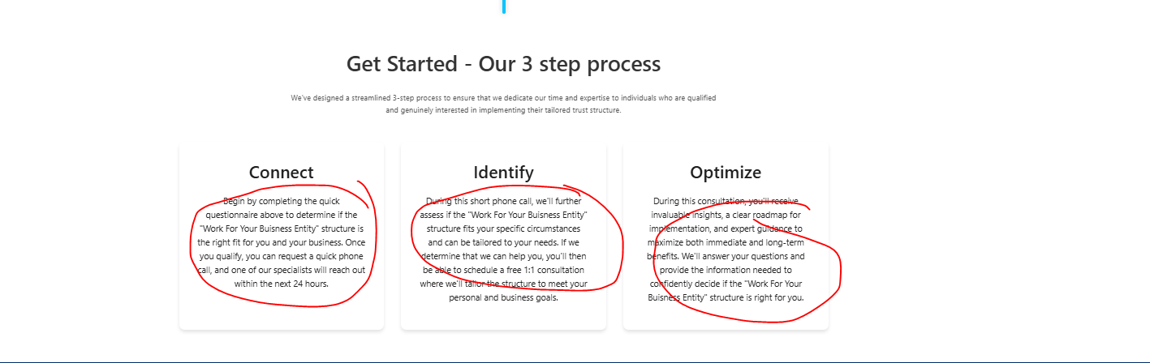
Change the circled text with this
Connect - Schedule your appointment through our right time works for you over the phone call.
Identify – Claim your first 30 minutes session for free, charges applied after 30 minutes session. Discuss your situation.
Optimize – We will assist you with our best service option applicable based your situation.

Slide 14
Resource Tab – Form link
FAQ are missing, please refer from doc file
All forms are not included
Please refer from linktree portal link- already provided

Slide 15
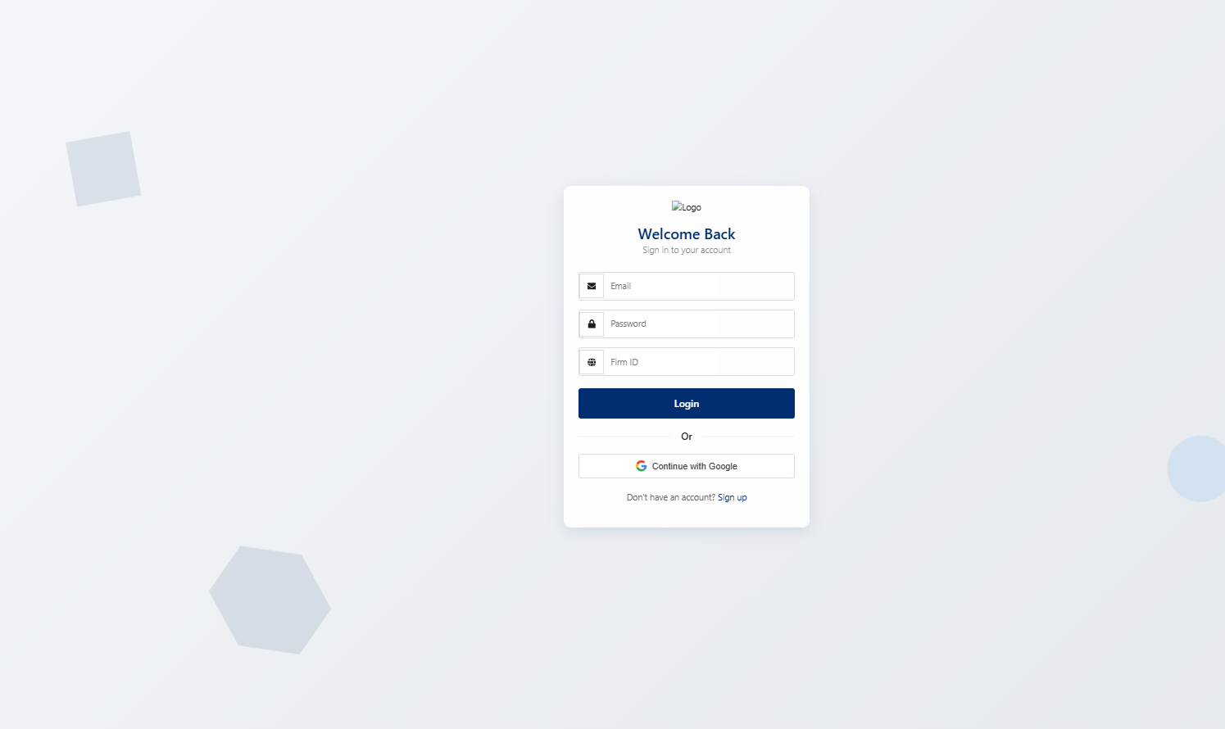
Login Page
Base color should be light/sky blue shade – big No for grey
Logo is missing
Graphics looks fine
Refer screenshot

Slide 16
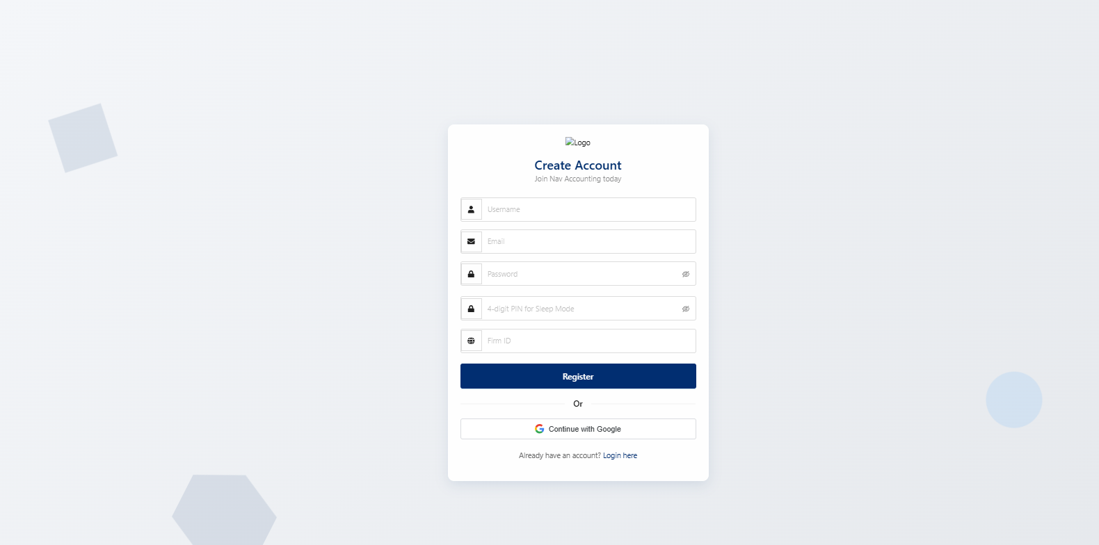
Register Page – Corrections
Logo is missing
Base color should be light/sky blue – not grey
Graphics looks fine
Refer the screenshot

